Slide 1

EC-101 Basics of Electronics & Communication Engineering
Module-1
By
Dr. Priyank Saxena
Assistant Professor

Slide 2
Course Objectives
This course enables the students:
To Understand PN Junction, diodes and their applications.
To comprehend BJT, FET and their bias configurations.
To grasp importance of feedback in amplifier circuits, op-amp and its applications.
To understand number system, Logic Gates and Boolean Algebra.
To apprehend fundamentals of communication technology.

Slide 3
Course Outcomes
After completion of this course, students will be able to:
Explain PN Junction, diodes and their applications.
Appraise the BJT, FET and their biasing techniques.
Comprehend feedback in amplifier circuits, op-amp and its applications.
Translate one number system into another, build circuits with Logic Gates, electronic components and Op-Amp IC741 and analyse the measurement results using CRO.
Appraise the fundamentals of communication technology.

Slide 4
Course Syllabus
Module-1 : Diodes and Applications Introduction to PN junction diodes; Characteristics of semiconductor diodes: V-I characteristics, diode-resistance, temperature- dependence, diode-capacitance; DC & AC load lines; Breakdown Mechanisms; Zener Diode — Operation and Applications; Diode as a Rectifier: Half Wave and Full Wave Rectifiers with and without C-Filters. {12 Lect. hours}
Module-2 : Bipolar Junction Transistor (BJT) Bipolar Junction Transistors (BJT): PNP and NPN Transistors, Basic Transistor Action, Input and Output Characteristics of CB, CE and CC Configurations, dc and ac load line analysis, operating point, Transistor biasing: Fixed bias, emitter bias/self-bias, Low-frequency response of CE amplifier. Field Effect Transistors: JFET, Idea of Channel Formation, Pinch-Off and saturation Voltage, Current-Voltage Output Characteristics; MOSFET: Basic structure, operation and characteristics. {12 Lect. hours}

Slide 5
Course Syllabus
Module-3 : Sinusoidal Oscillators Sinusoidal Oscillators: Concept of positive and negative feedback, Barkhausen criterion for sustained oscillations, Determination of Frequency and Condition of oscillation, Hartley and Colpitt’s oscillator. Operational Amplifiers: Operational Amplifiers: Characteristics of an Ideal and Practical Operational Amplifier (IC 741), Inverting and non-inverting amplifiers, Offset error voltages and currents; Power supply rejection ratio, Slew Rate and concept of Virtual Ground, Summing and Difference Amplifiers, Differentiator and Integrator, RC phase shift oscillator. {8 Lect. hours}
Module-4 : Logic Gates and Boolean Algebra Logic Gates and Boolean algebra: Introduction to Boolean Algebra and Boolean operators, Symbolic representation, Boolean algebraic function and Truth table of different Digital logic Gates (AND, OR, NOT, NAND, NOR, EX- OR, EX-NOR); Realization of Basic logic gates using universal gates, Adder, Subtractor, adder/subtractor. {8 Lect. hours}

Slide 6
Course Syllabus
Module-5 : Electronic Communication Electronic communication: Introduction to electronic communication system, Electromagnetic Communication spectrum band and applications, Elements of Electronic Communication System; Merits and demerits of analog and digital communication, Modes of communication; Signal radiation and propagation; Need for modulation; Introduction to Amplitude and Angle modulation. {10 Lect. hours}
Text Books: Millman J. Halkias C. C., Parikh Chetan, “ Integrated Electronics: Analog and Digital Circuits and Systems”, Tata McGraw-Hill, 2/e. Mano M. M., “ Digital Logic and Computer Design”, Pearson Education, Inc. Thirteenth Impression, 2011. Singhal T. L., “ Analog and Digital Communications”, Tata McGraw-Hill, 2/e. Haykin S. Moher M., “ Introduction to Analog and Digital Communications”, Wiley India Pvt. Ltd., 2/e. Reference Books: 1. Bolystead R. L., Nashelsky L., “ Electronic Devices and Circuit Theory”, Pearson Education, Inc, 10/e.

Slide 7
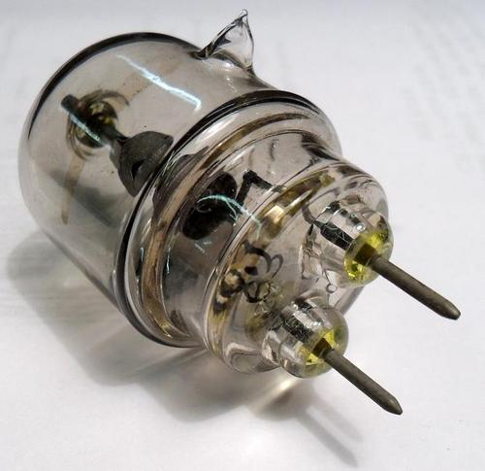
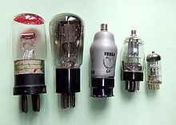
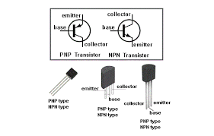
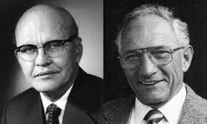
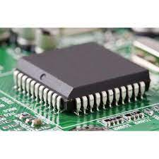
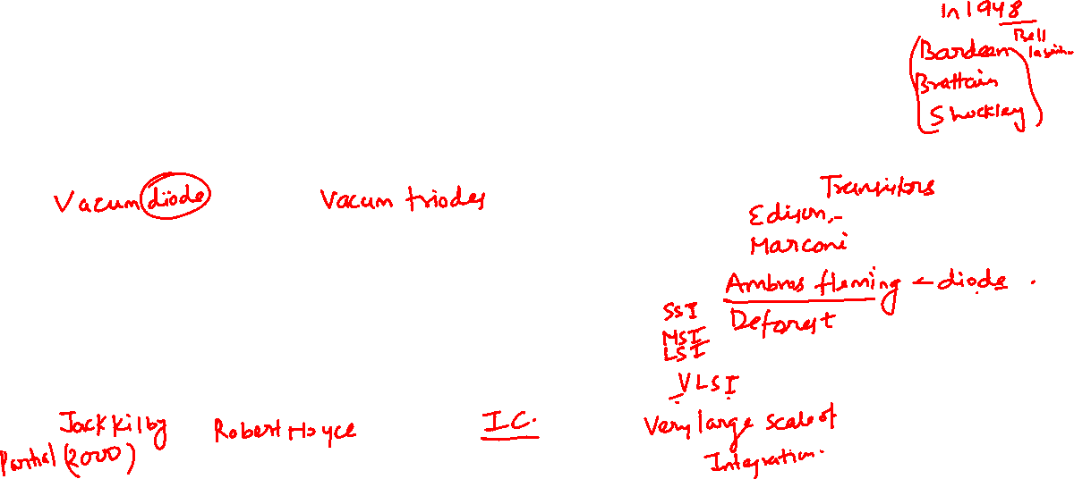
History

Slide 8
Introduction
Electronics: The branch of engineering which deals with current
conduction through a vacuum or gas or semiconductor
is known as *electronics.
* The word electronics derives its name from electron present in all materials.
Electronics essentially deals with electronic devices and their utilization.
Electronic Device: An electronic device is that in which current flows through a vacuum or gas or semiconductor.
Such devices have valuable properties which enable them to function and behave as the friend of man today.

Slide 9
Introduction
Electronics has gained much importance due to its numerous applications in industry.
The electronic devices are capable of performing the following functions (a few) :
Rectification
Amplification
Control
Generation
Conversion of light into electricity
Conversion of electricity into light

Slide 10
Introduction
Rectification: The conversion of a.c. into d.c. is called rectification.
Electronic devices can convert a.c. power into d.c. power with very high efficiency.
This d.c. supply can be used for charging storage batteries, field supply of d.c. generators, electroplating etc.
Amplification: The process of raising the strength of a weak signal is
known as amplification.
Electronic devices can accomplish the job of amplification and thus act as amplifiers.
The amplifiers are used in a wide variety of ways. For example, an amplifier is used in a radio set where the weak signal is amplified so that it can be heard loudly. Similarly, amplifiers are used in public address system, television etc.

Slide 11
Introduction
Control: Electronic devices find wide applications in automatic control.
For example, speed of a motor, voltage across a refrigerator etc. can
be automatically controlled with the help of such devices.
Generation: Electronic devices can convert d.c. power into a.c. power of any frequency. When performing this function, they are known as oscillators.
The oscillators are used in a wide variety of ways. For example, electronic high frequency heating is used for annealing and hardening.

Slide 12
Introduction
Conversion of light into electricity: Electronic devices can
convert light into electricity.
This conversion of light into electricity is known as photo-electricity. Photo-electric devices are used in Burglar alarms, sound recording on motion pictures etc
Conversion of electricity into light: Electronic devices can convert electricity into light.
This valuable property is utilized in television and radar.

Slide 13
Atomic Structure
Atomic Structure:
According to the modern theory, matter is electrical in nature.
All matter is composed of very small particles called atoms.
An atom consists of a central nucleus of positive charge around which small negatively charged particles, called electrons revolve in different paths or orbits.
Nucleus: It is the central part of an atom and contains protons and neutrons.
A proton is a positively charged particle, while the neutron has the same mass as the proton but has no charge. Therefore, the nucleus of an atom is positively charged.

Slide 14
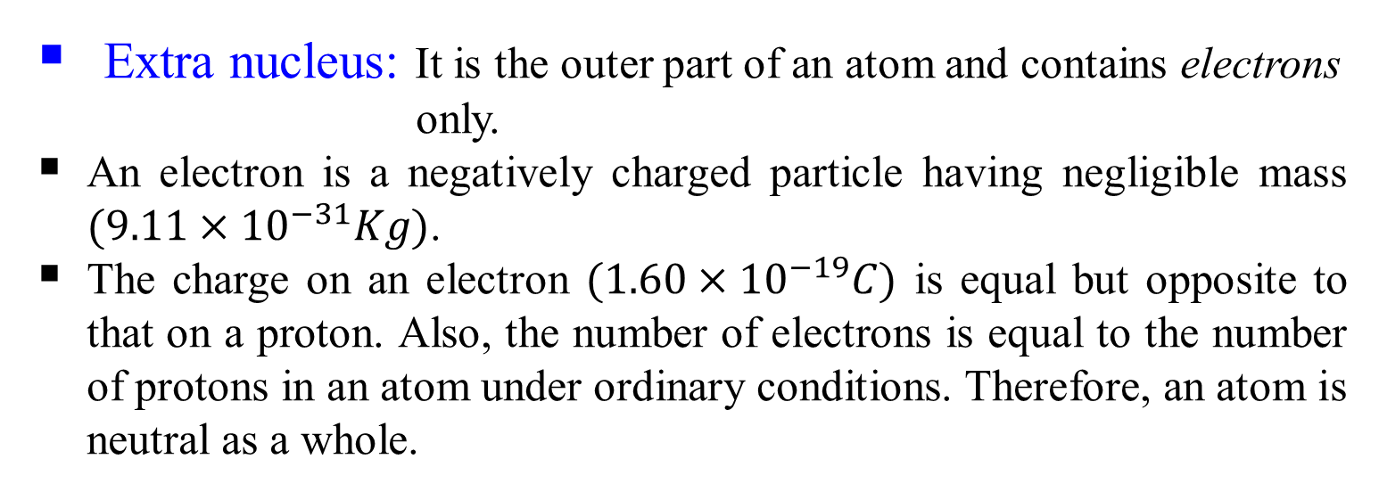
Atomic Structure (Contd.)
The sum of protons and neutrons constitutes the entire weight of an atom and is called atomic weight. It is because the particles in the extra nucleus (i.e. electrons) have negligible weight as compared to protons or neutrons.
Atomic weight = no. of protons + no. of neutrons

Slide 15
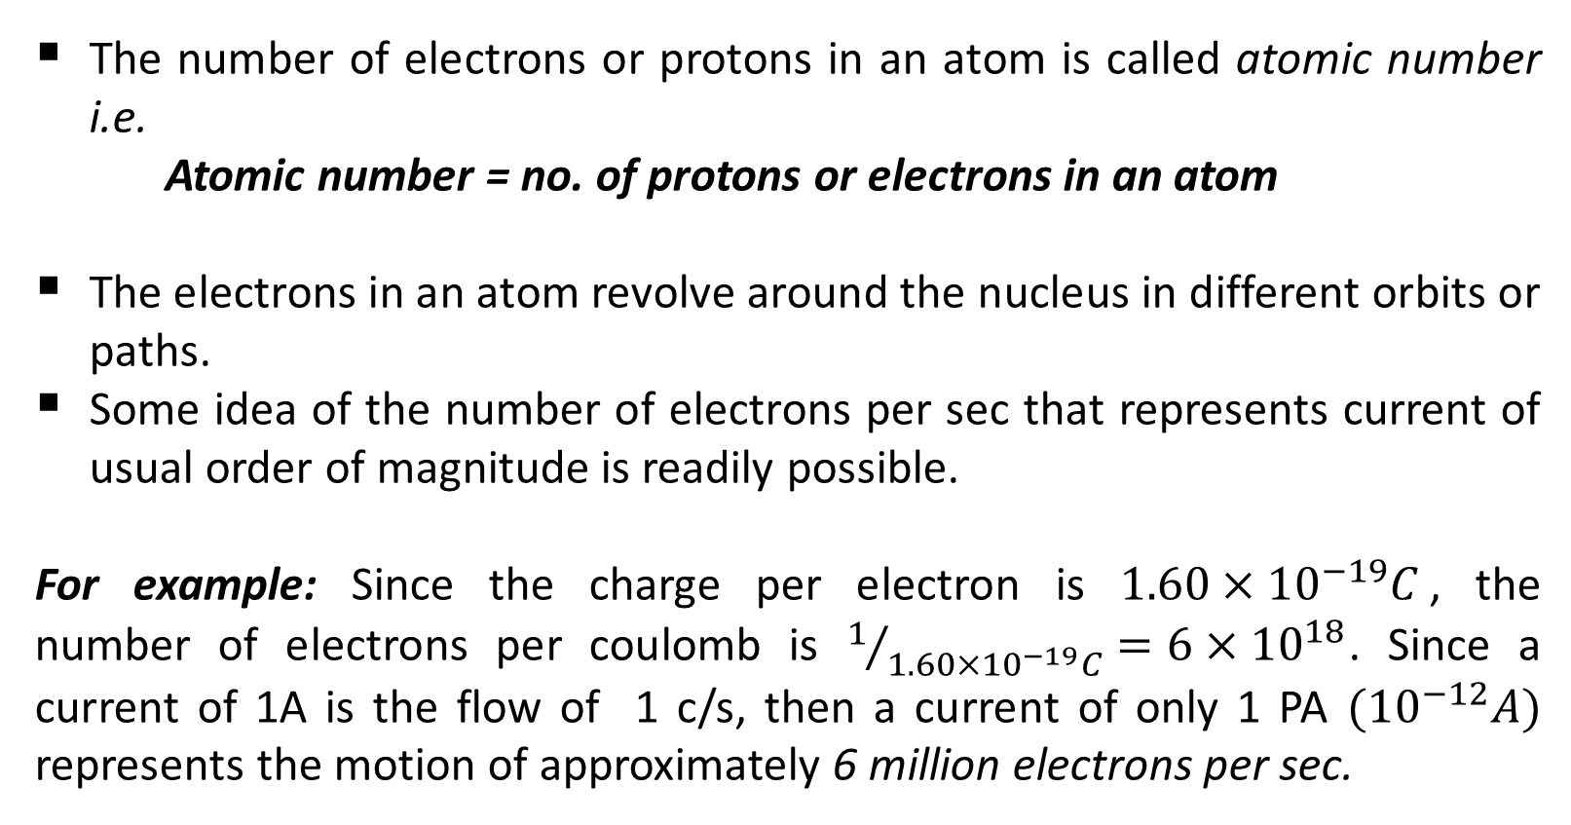
Atomic Structure (Contd.)
The number of electrons or protons in an atom is called atomic number i.e.
Atomic number = no. of protons or electrons in an atom
The electrons in an atom revolve around the nucleus in different orbits or paths.
Some idea of the number of electrons per sec that represents current of usual order of magnitude is readily possible.
For example: Since the charge per electron is $1.60×{10}^{−19}C$, the number of electrons per coulomb is $1/{1.60×{10}^{−19}C}=6×{10}^{18}$. Since a current of 1A is the flow of 1 c/s, then a current of only 1 PA $({10}^{−12}A)$ represents the motion of approximately 6 million electrons per sec.

Slide 16
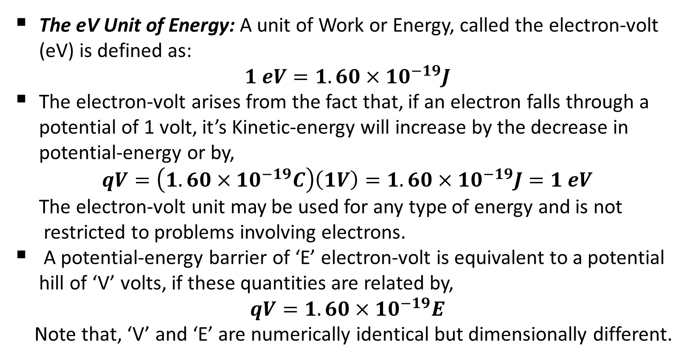
Atomic Structure (Contd.)
The eV Unit of Energy: A unit of Work or Energy, called the electron-volt (eV) is defined as:
$$1 eV=1.60×{10}^{−19}J$$
The electron-volt arises from the fact that, if an electron falls through a potential of 1 volt, it’s Kinetic-energy will increase by the decrease in potential-energy or by,
$$qV=\left(1.60×{10}^{−19}C\right)\left(1V\right)=1.60×{10}^{−19}J=1 eV$$
The electron-volt unit may be used for any type of energy and is not
restricted to problems involving electrons.
A potential-energy barrier of ‘E’ electron-volt is equivalent to a potential hill of ‘V’ volts, if these quantities are related by,
$$qV=1.60×{10}^{−19}E$$
Note that, ‘V’ and ‘E’ are numerically identical but dimensionally different.

Slide 17
Energy of an Electron
An electron moving around the nucleus possesses two types of energies viz. kinetic energy due to its motion and potential energy due to the charge on the nucleus.
The total energy of the electron is the sum of these two energies.
The energy of an electron increases as its distance from the nucleus increases.
Thus, an electron in the second orbit possesses more energy than the electron in the first orbit; electron in the third orbit has higher energy than in the second orbit. It is clear that electrons in the last orbit possess very high energy as compared to the electrons in the inner orbits.
These last orbit electrons play an important role in determining the physical, chemical and electrical properties of a material.

Slide 18
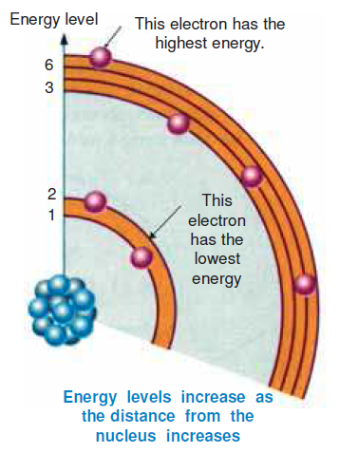

Energy of an Electron
Fig.1-4[Energy levels increase as the distance from the nucleus increases]

Slide 19

Valence Electrons
This outermost shell is known as the valence shell and electrons in this shell are called valence electrons.
These valence electrons contribute to chemical reactions and bonding within the structure of a material and determine its electrical properties.
These electrons determine whether the material is chemically active or not, metal or non-metal or, a gas or solid.
When a valence electron gains sufficient energy from an external source, it can break free from its atom. This is the basis for conduction in materials.

Slide 20
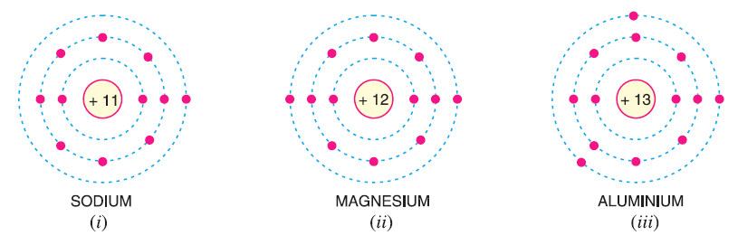

Valence Electrons (Contd.)
When the number of valence electrons of an atom is less than 4 (i.e. half of the maximum eight electrons), the material is usually a metal and a conductor. Examples are sodium, magnesium and aluminium which have 1, 2 and 3 valence electrons respectively (See Fig. 1-5).
Fig.1-5

Slide 21
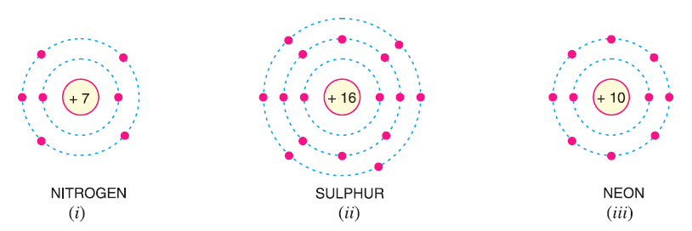
Valence Electrons (Contd.)
When the number of valence electrons of an atom is more than 4, the material is usually a non-metal and an insulator. Examples are nitrogen, sulphur and neon which have 5, 6 and 8 valence electrons respectively (See Fig. 1-6).
Fig.1-6

Slide 22
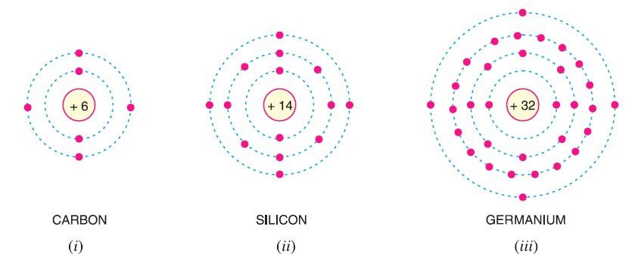

Valence Electrons (Contd.)
When the number of valence electrons of an atom is 4 (i.e. exactly one-half of the maximum 8 electrons), the material has both metal and non-metal properties and is usually a semiconductor. Examples are carbon, silicon and germanium (See Fig. 1-7).
Fig.1-7

Slide 23

Free Electrons
The valence electrons of different materials possess different energies. The greater the energy of a valence electron, the lesser it is bound to the nucleus.
In certain substances, particularly metals, the valence electrons possess so much energy that they are very loosely attached to the nucleus. These loosely attached valence electrons move at random within the material and are called free electrons.
The valence electrons which are very loosely attached to the nucleus are known as free electrons.

Slide 24
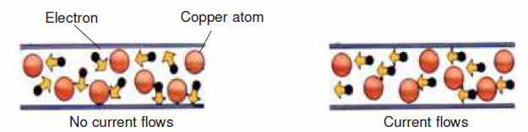

Free Electrons (Contd.)
The free electrons can be easily removed or detached by applying a
small amount of external energy. As a matter of fact, these are the
free electrons which determine the electrical conductivity of a
material.
Fig.1-8[Current moves through materials that conduct electricity]

Slide 25

Free Electrons (Contd.)
On this basis of the availability of free electrons, conductors, insulators and semiconductors can be defined as under :
A conductor is a substance which has a large number of free electrons. When potential difference is applied across a conductor, the free electrons move towards the positive terminal of supply, constituting electric current.
An insulator is a substance which has practically no free electrons at ordinary temperature. Therefore, an insulator does not conduct current under the influence of potential difference.
A semiconductor is a substance which has very few free electrons at room temperature. Consequently, at room temperature, a semiconductor practically conducts no current.

Slide 26
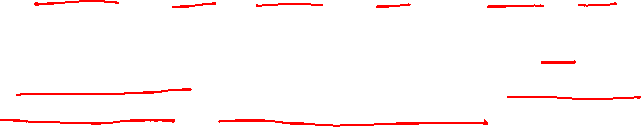
Electron Emission
The liberation of electrons from the surface of a substance is known as electron emission.
If a piece of metal is investigated at room temperature, the random motion of free electrons are free only to the extent that they may transfer from one atom to another within the metal, but they cannot leave the metal surface to provide electron emission.
It is because the free electrons that start at the surface of metal find behind them positive nuclei pulling them back and none pulling forward.
Thus at the surface of a metal, a free electron encounters forces that prevent it to leave the metal. In other words, the metallic surface offers a barrier to free electrons and is known as surface barrier.

Slide 27

Electron Emission (Contd.)
However, if sufficient external energy is given to the free electron, its kinetic energy is increased and thus electron will cross over the surface barrier to leave the metal.
This additional energy required by an electron to overcome the surface barrier of the metal i.e., to emit an electron from a metallic surface is known as work function of that metal.
Thus, if the total energy required to liberate an electron from a metal is 4 eV and the energy already possessed by the electron is 0.5 eV, then additional energy required (i.e., work function) is 4.0− 0.5 = 3.5 eV. The work function depends upon the nature of metal, its purity and the conditions of its surface.
It may be noted that it is desirable that metal used for electron emission should have low work function so that a small amount of energy is required to cause emission of electrons.

Slide 28
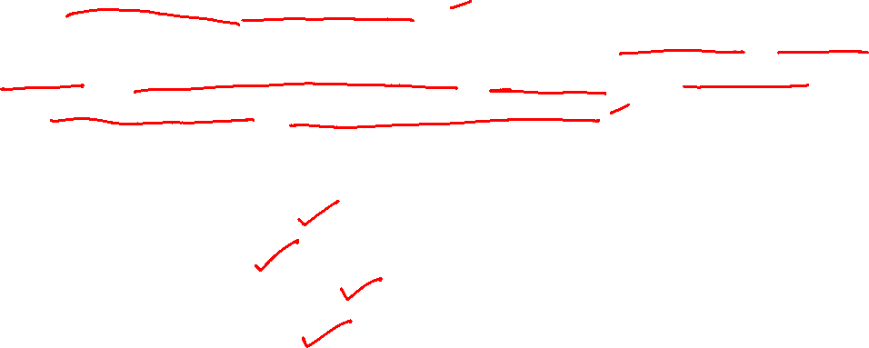

Electron Emission (Contd.)
The electron emission from the surface of a metal is possible only if sufficient additional energy (equal to the work function of the metal) is supplied from some external source.
This external energy may come from a variety of sources such as heat energy, energy stored in electric field, light energy or kinetic energy of the electric charges bombarding the metal surface.
Accordingly, there are following four principal methods of obtaining electron emission from the surface of a metal.
Thermionic emission
Field emission
Photo-electric emission
Secondary emission

Slide 29
Electron Emission (Contd.)
Thermionic emission:
In this method, the metal is heated to sufficient temperature (about 2500ºC) to enable the free electrons to leave the metal surface.
The number of electrons emitted depends upon the temperature. The higher the temperature, the greater is the emission of electrons.
This type of emission is employed in vacuum tubes.
Field emission:
In this method, a strong electric field (i.e., a high positive voltage) is applied at the metal surface which pulls the free electrons out of metal because of the attraction of positive field.
The stronger the electric field, the greater is the electron emission.

Slide 30
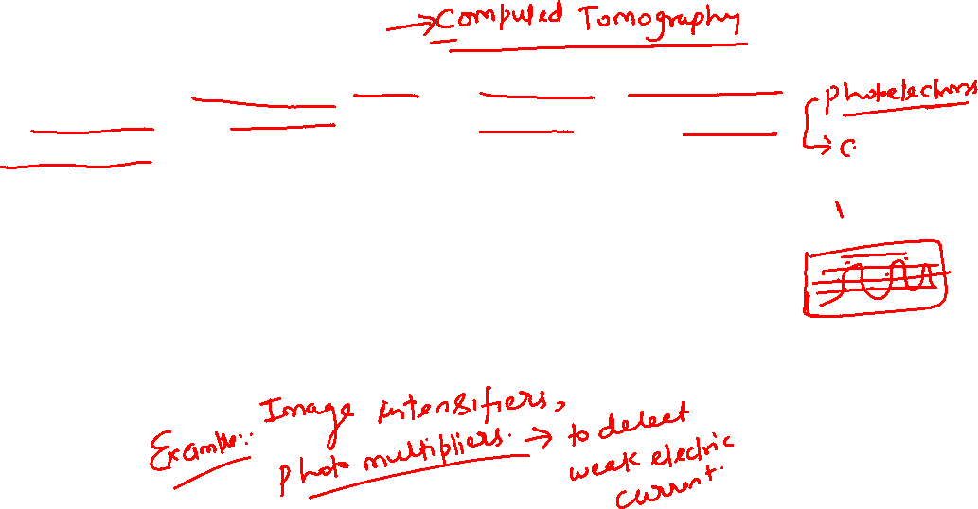
Electron Emission (Contd.)
Photo-electric emission:
In this method, the energy of light falling upon the metal surface is transferred to the free electrons within the metal to enable them to leave the surface.
The greater the intensity (i.e., brightness) of light beam falling on the metal surface, the greater is the photo-electric emission.
Secondary emission:
In this method, a high velocity beam of electrons strikes the metal
surface and causes the free electrons of the metal to be knocked out
from the surface.

Slide 31
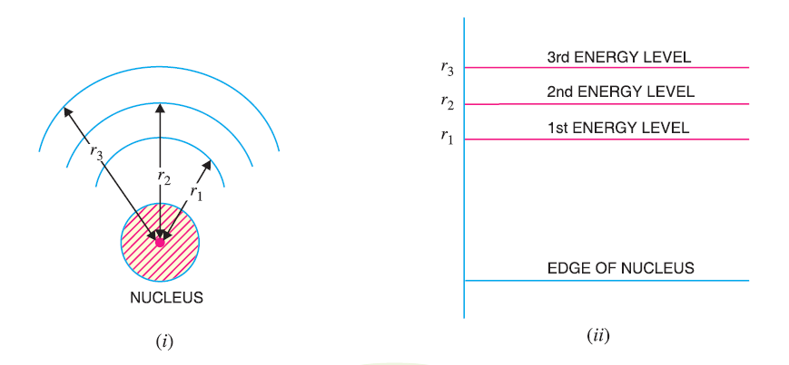

Energy levels in solid
It has already been discussed that each orbit has fixed amount of energy associated with it. The electrons moving in a particular orbit possess the energy of that orbit.
The larger the orbit, the greater is its energy. It becomes clear that outer orbit electrons possess more energy than the inner orbit electrons.
A convenient way of representing the energy of different orbits is shown in Fig.1-9 (ii). This is known as Energy Level Diagram or Energy Band Diagram.
Fig.1-9[Energy level diagram]

Slide 32
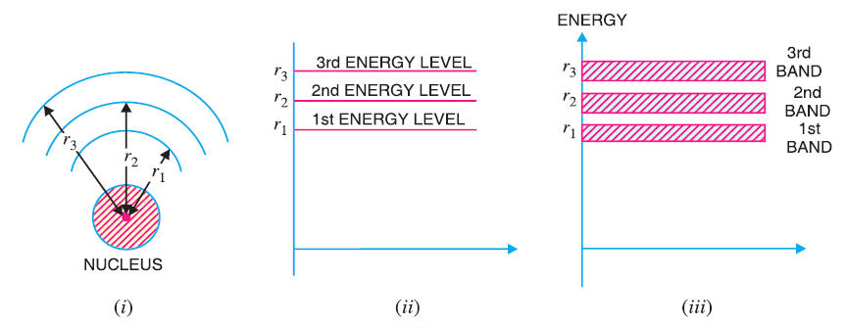
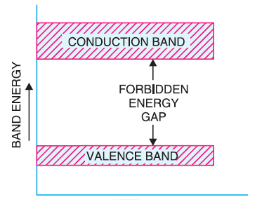
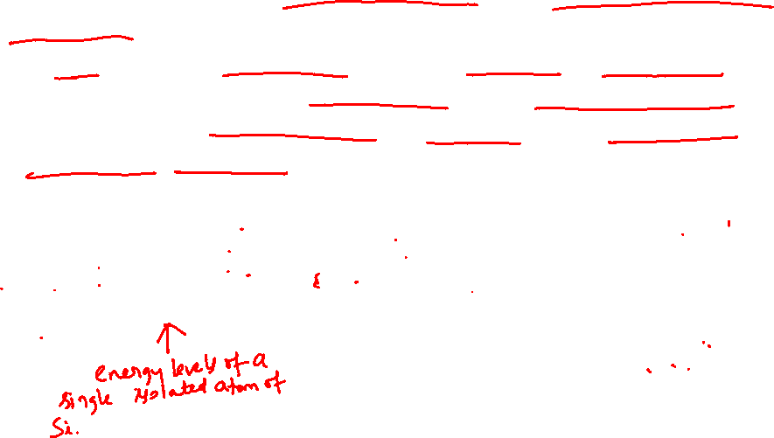
Energy Bands in Solids
The range of energies possessed by an electron in a solid is known as energy band.
In a solid, the electron in any orbit can have a range of energies. For instance, electrons in the first orbit have slightly different energies. Since there are millions of first orbit electrons, the slightly different energy levels form a band.
Fig.1-10[Energy band diagram]
Fig.1-11

Slide 33

Energy Bands in Solids (Contd.)
Valence Band: The range of energies (i.e. band) possessed by valence electrons is known as valence band.
The electrons in the outermost orbit of an atom are known as valence electrons.
In a normal atom, valence band has the electrons of highest energy.
This type of band may be complete or partially-filled.
In case of inert gases, the valence band is filled whereas for other materials, it is only partially filled.
The partially filled band can accommodate more electrons.

Slide 34

Energy Bands in Solids (Contd.)
Conduction Band: The range of energies (i.e., band) possessed by
conduction band electrons is known as conduction band.
In conduction band, electrons can move freely and are known as conduction electrons.
The conduction band is empty for insulators and only partially filled for conductors.
The minimum energy of an electron in this band is zero in which case it will be just out of the nucleus hold.

Slide 35

Energy Bands in Solids (Contd.)
Forbidden energy gap: The separation between conduction band and valence band on the energy level diagram is known as forbidden energy gap.
No electron of a solid can stay in a forbidden energy gap as there is no allowed energy state in this region.
The width of the forbidden energy gap is a measure of the bondage of valence electrons to the atom.
The greater the energy gap, more tightly the valence electrons are bound to the nucleus.
In order to push an electron from valence band to the conduction band (i.e., to make the valence electron free), external energy equal to the forbidden energy gap must be supplied.
E_{g} (Ge) = 0.785eV, E_{g} (Si) = 1.1eV

Slide 36
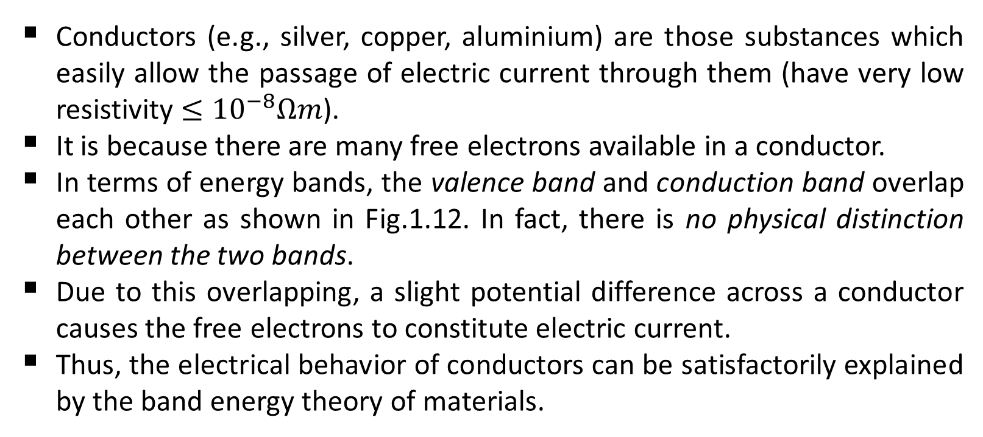

Classification of Solids (Contd.)
Conductors:
Conductors (e.g., silver, copper, aluminium) are those substances which easily allow the passage of electric current through them (have very low resistivity $≤{10}^{−8}Ωm$).
It is because there are many free electrons available in a conductor.
In terms of energy bands, the valence band and conduction band overlap each other as shown in Fig.1.12. In fact, there is no physical distinction between the two bands.
Due to this overlapping, a slight potential difference across a conductor causes the free electrons to constitute electric current.
Thus, the electrical behavior of conductors can be satisfactorily explained by the band energy theory of materials.

Slide 37
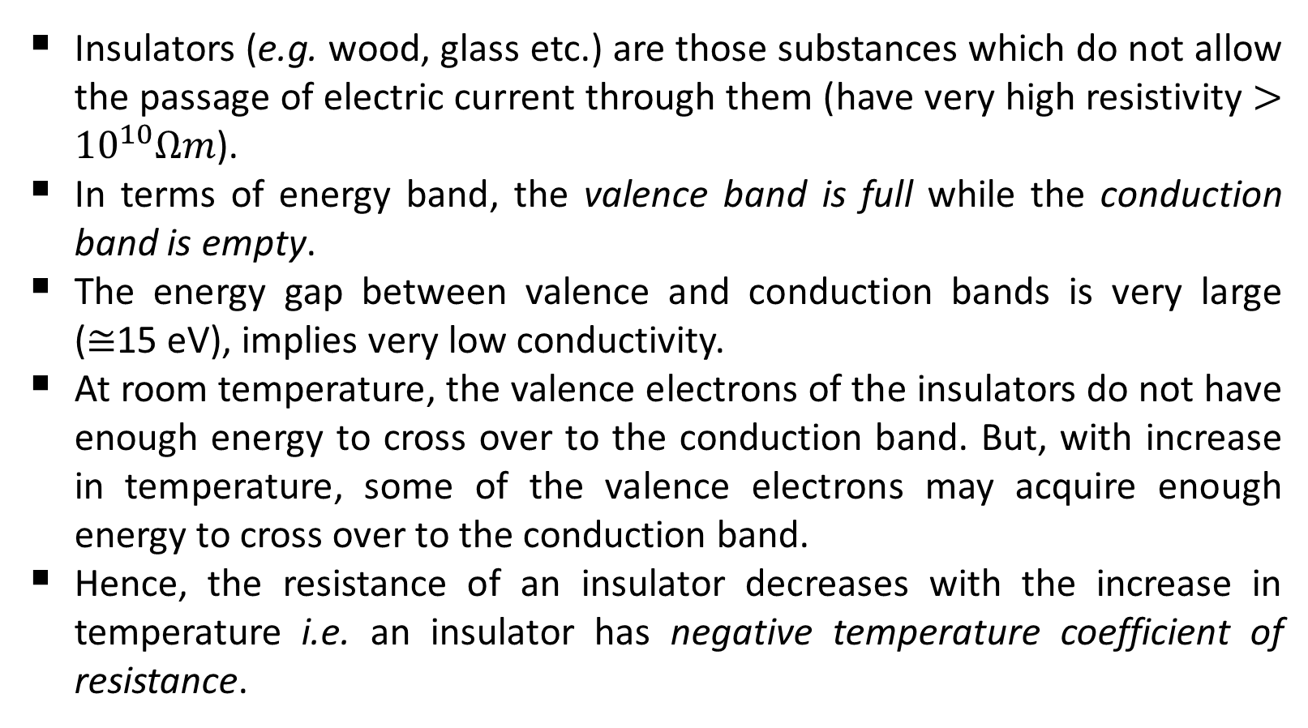

Classification of Solids (Contd.)
Insulators:
Insulators (e.g. wood, glass etc.) are those substances which do not allow the passage of electric current through them (have very high resistivity $>{10}^{10}Ωm$).
In terms of energy band, the valence band is full while the conduction band is empty.
The energy gap between valence and conduction bands is very large ($≅$15 eV), implies very low conductivity.
At room temperature, the valence electrons of the insulators do not have enough energy to cross over to the conduction band. But, with increase in temperature, some of the valence electrons may acquire enough energy to cross over to the conduction band.
Hence, the resistance of an insulator decreases with the increase in temperature i.e. an insulator has negative temperature coefficient of resistance.

Slide 38
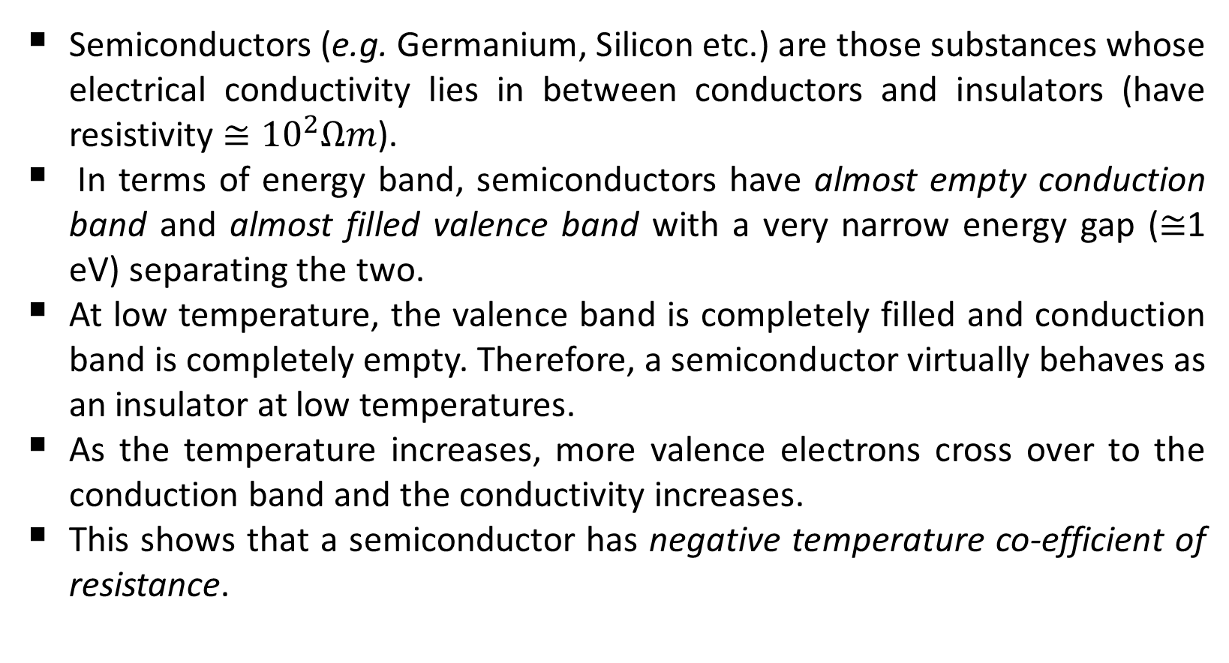

Classification of Solids (Contd.)
Semiconductors:
Semiconductors (e.g. Germanium, Silicon etc.) are those substances whose electrical conductivity lies in between conductors and insulators (have resistivity $≅{10}^{2}Ωm$).
In terms of energy band, semiconductors have almost empty conduction band and almost filled valence band with a very narrow energy gap ($≅$1 eV) separating the two.
At low temperature, the valence band is completely filled and conduction band is completely empty. Therefore, a semiconductor virtually behaves as an insulator at low temperatures.
As the temperature increases, more valence electrons cross over to the conduction band and the conductivity increases.
This shows that a semiconductor has negative temperature co-efficient of resistance.

Slide 39
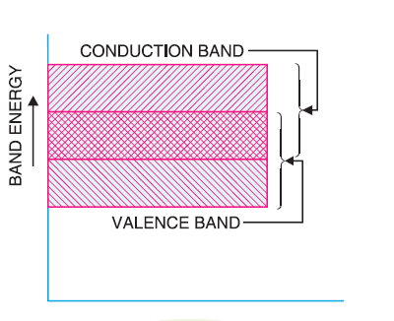
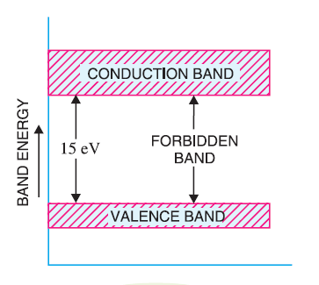
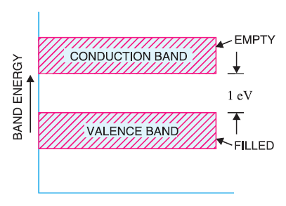
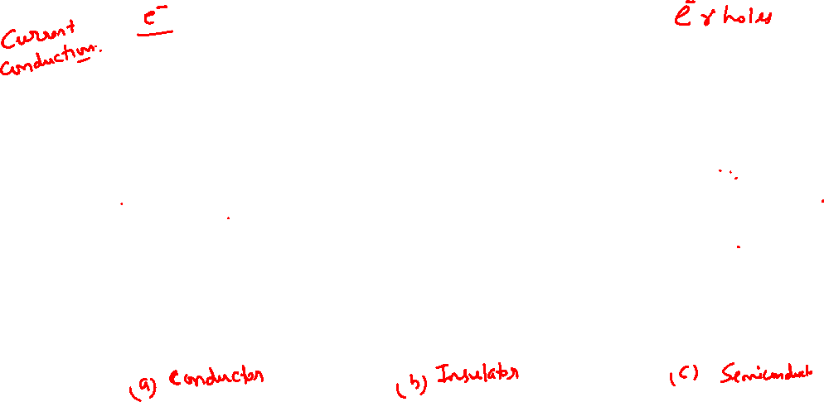
Classification of Solids (Contd.)
Fig.1-12 [Energy band diagram of Conductor, Insulator and Semiconductor]

Slide 40

Semiconductors
The construction of every discrete (individual) solid-state (hard crystal structure) electronic device or integrated circuit begins with a semiconductor material of the highest quality.
In general, semiconductor materials fall into one of two classes: single-crystal and compound.
Single-crystal semiconductors such as germanium (Ge) and silicon (Si) have a repetitive crystal structure, whereas compound semiconductors such as gallium arsenide (GaAs), cadmium sulfide (CdS), gallium nitride (GaN), and gallium arsenide phosphide (GaAsP) are constructed of two or more semiconductor materials of different atomic structures.
The three semiconductors used most frequently in the construction of electronic devices are Ge, Si, and GaAs.

Slide 41
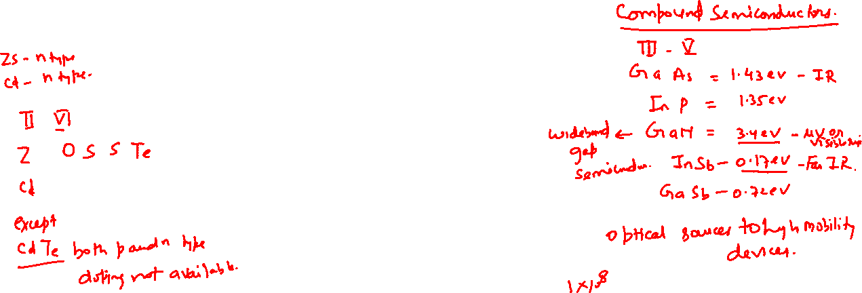
Semiconductors
The single-crystal semiconductors are classified as:
Pure form of semiconductor (Intrinsic semiconductor)
Silicon (Si)
Germanium (Ge)
Impure form of semiconductor (Extrinsic semiconductor)
n-type extrinsic semiconductor
p-type extrinsic semiconductor

Slide 42
Intrinsic Semiconductors
A semiconductor in an extremely pure form is known as an intrinsic semiconductor.
In an intrinsic semiconductor, even at room temperature, hole-electron pairs are created. When electric field is applied across an intrinsic semiconductor, the current conduction takes place by two processes, namely: by free electrons and holes.
The free electrons are produced due to the breaking up of some covalent bonds by thermal energy.
At the same time, holes are created in the covalent bonds.
Under the influence of electric field, conduction through the semiconductor is by both free electrons and holes.
Therefore, the total current inside the semiconductor is the sum of currents due to free electrons and holes.

Slide 43
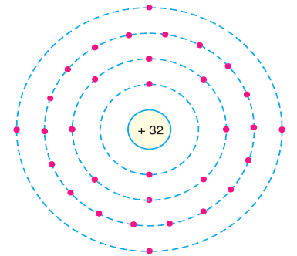
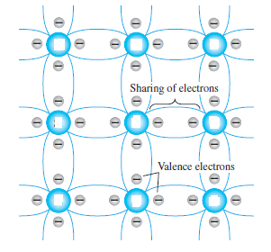

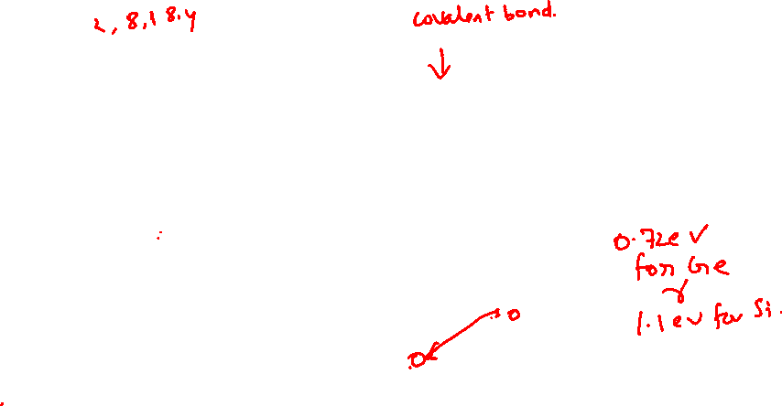
Intrinsic Semiconductors
Ge
Ge
Ge
Ge
Ge
Ge
Ge
Ge
Ge
Fig.1-14[Crystal structure of Ge illustrated with covalent bonding
symbolically in two-dimensions]

Slide 44
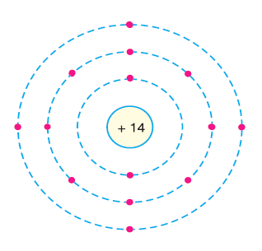
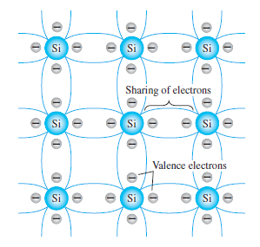
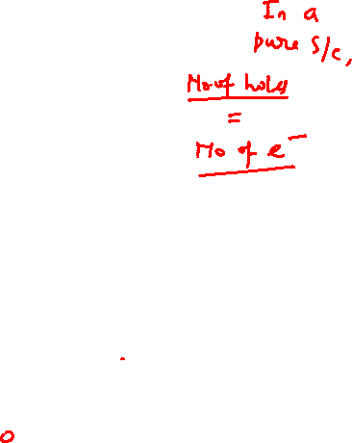
Intrinsic Semiconductors
Fig.1-13[Crystal structure of Si illustrated with covalent bonding
symbolically in two-dimensions]

Slide 45
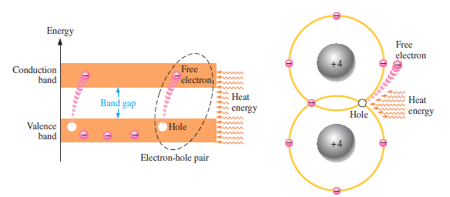
Intrinsic Semiconductors
Fig.1-15 [Creation of electron-hole pairs in a silicon crystal.
Electrons in the conduction band are free electrons]

Slide 46
Intrinsic Semiconductors
Fig.1-15 [Creation of electron-hole pairs in a silicon crystal.
Electrons in the conduction band are free electrons]

Slide 47
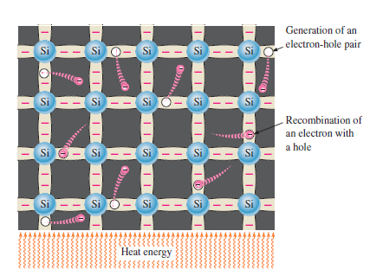

Intrinsic Semiconductors
Fig.1-16 [Electron-hole pairs in a silicon crystal. Free electrons are being
generated continuously while some recombine with holes]

Slide 48
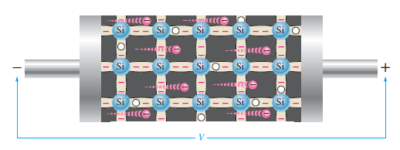
Intrinsic Semiconductors
Fig.1-17 [Electron current in intrinsic silicon is produced
by the movement of thermally generated free electrons]

Slide 49
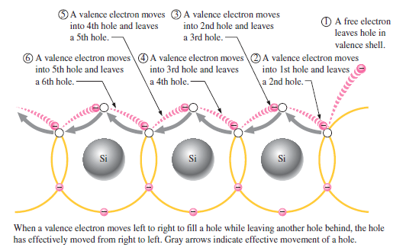
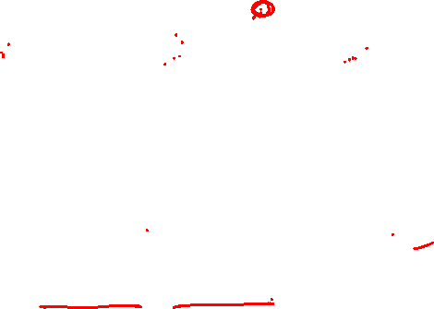
Intrinsic Semiconductors
Fig.1-18 [Hole current in intrinsic silicon]

Slide 50
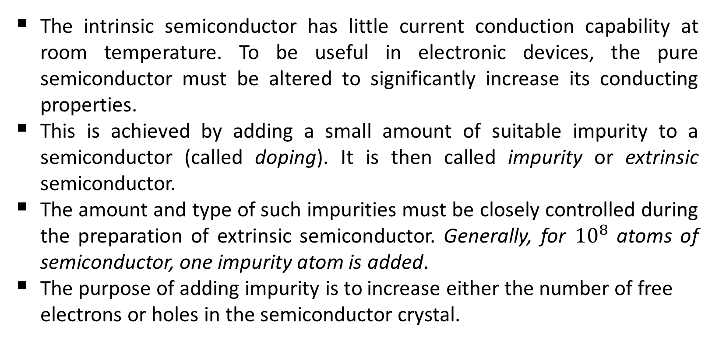

Extrinsic Semiconductors
The intrinsic semiconductor has little current conduction capability at room temperature. To be useful in electronic devices, the pure semiconductor must be altered to significantly increase its conducting properties.
This is achieved by adding a small amount of suitable impurity to a semiconductor (called doping). It is then called impurity or extrinsic semiconductor.
The amount and type of such impurities must be closely controlled during the preparation of extrinsic semiconductor. Generally, for ${10}^{8}$ atoms of semiconductor, one impurity atom is added.
The purpose of adding impurity is to increase either the number of free electrons or holes in the semiconductor crystal.

Slide 51
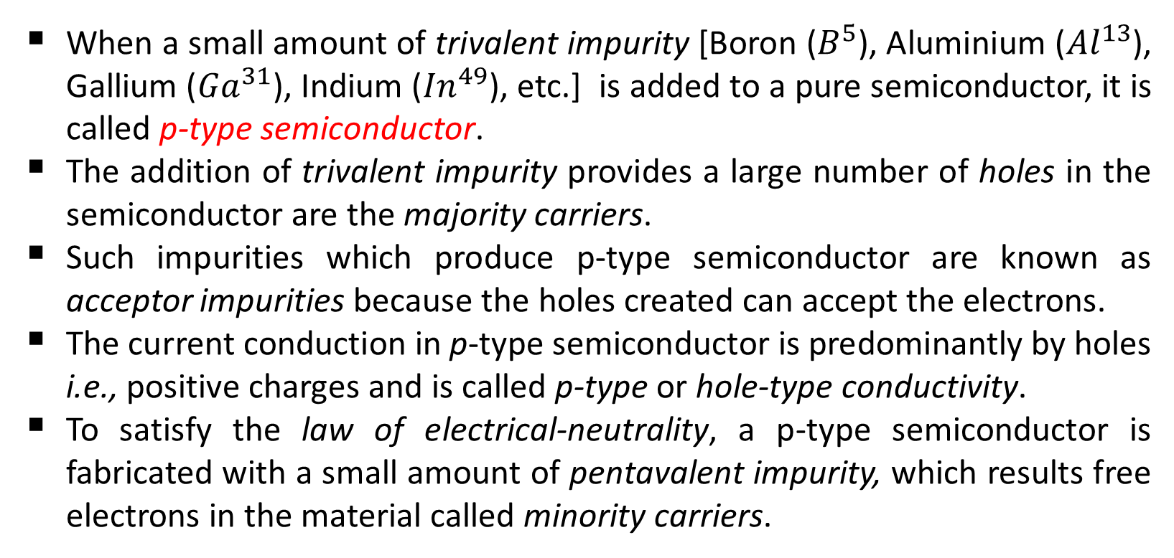

Extrinsic Semiconductors
When a small amount of trivalent impurity [Boron ($B^{5}$), Aluminium (${Al}^{13}$), Gallium (${Ga}^{31}$), Indium (${In}^{49}$), etc.] is added to a pure semiconductor, it is called p-type semiconductor.
The addition of trivalent impurity provides a large number of holes in the semiconductor are the majority carriers.
Such impurities which produce p-type semiconductor are known as acceptor impurities because the holes created can accept the electrons.
The current conduction in p-type semiconductor is predominantly by holes i.e., positive charges and is called p-type or hole-type conductivity.
To satisfy the law of electrical-neutrality, a p-type semiconductor is fabricated with a small amount of pentavalent impurity, which results free electrons in the material called minority carriers.

Slide 52
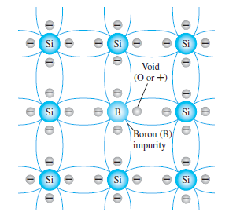
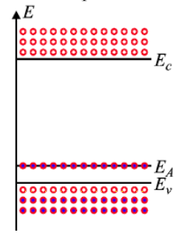

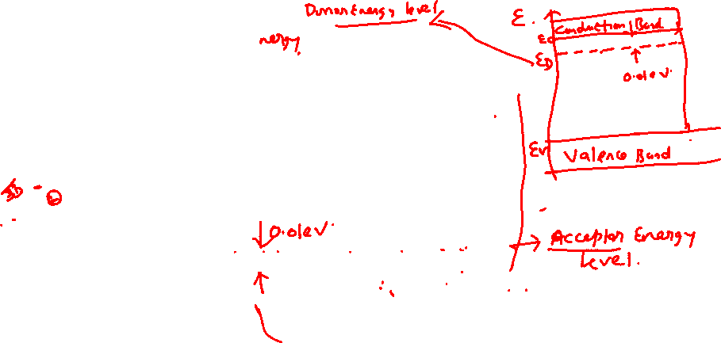

Extrinsic Semiconductors
Fig.1-19-a [Boron impurity in
p-type material]
Fig.1-19-b [Effect of donor impurities
on the energy band structure]

Slide 53
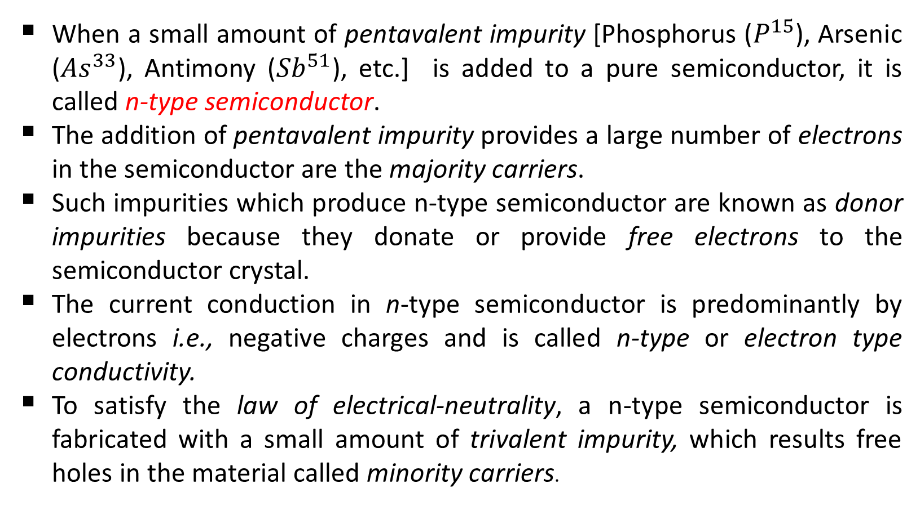

Extrinsic Semiconductors
When a small amount of pentavalent impurity [Phosphorus ($P^{15}$), Arsenic (${As}^{33}$), Antimony (${Sb}^{51}$), etc.] is added to a pure semiconductor, it is called n-type semiconductor.
The addition of pentavalent impurity provides a large number of electrons in the semiconductor are the majority carriers.
Such impurities which produce n-type semiconductor are known as donor impurities because they donate or provide free electrons to the semiconductor crystal.
The current conduction in n-type semiconductor is predominantly by electrons i.e., negative charges and is called n-type or electron type conductivity.
To satisfy the law of electrical-neutrality, a n-type semiconductor is fabricated with a small amount of trivalent impurity, which results free holes in the material called minority carriers.

Slide 54
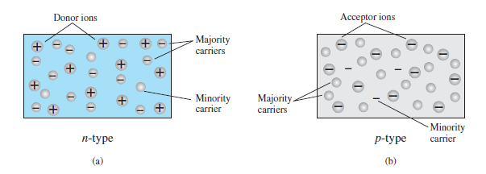
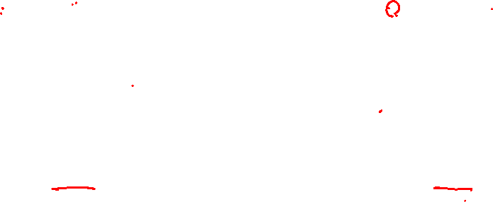
Extrinsic Semiconductors
Fig.1-21[(a) n-type material; (b) p-type material]

Slide 55
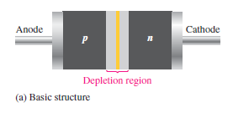




PN Junction
In a piece of semiconductor material (pure form), if one half is doped with p-type impurity and the other half with n-type impurity, a pn- junction forms at the boundary between the two regions and is called pn- junction diode or junction diode or pn-diode or semiconductor diode.
Fig.1.2.1 [pn-diode basic structure and symbol]

Slide 56



PN Junction

Slide 57







P-N Junction
$$Acceptor ion N_{A}$$
$$Donor ion N_{D}$$
Fig.1.2.2.a [The basic silicon structure at the instant of junction formation]
Fig.1.2.2.b [The basic silicon structure
at equilibrium]

Slide 58



PN Junction
At the instant of pn-junction formation, the free electrons near the junction in the n region begin to diffuse across the junction into the p region where they combine with holes near the junction. The result is that n region loses free electrons as they diffuse into the junction. This creates a layer of positive charges (donor ions $N_{D}$) near the junction.

Slide 59



PN Junction
As the electrons move across the junction, the p region loses holes as the electrons and holes combine. The result is that there is a layer of negative charges (acceptor ions $N_{A}$) near the junction.
These two layers of positive and negative charges form the depletion region/depletion layer/space-charge region/transition region (0.5$μm)$.
The term depletion is due to the fact that near the junction, the region is depleted (i.e. emptied) of charge carries (free electrons and holes) due to diffusion across the junction.
It may be noted that depletion layer is formed very quickly and is very thin compared to the n region and the p region.
Once pn-junction is formed and depletion layer created, the further diffusion of free electrons and holes stops. In other words, the depletion region acts as a barrier to the further movement of free electrons and holes across the junction.

Slide 60


PN Junction
Fig.1.2.4 [A schematic diagram of pn-Junction with charge density]

Slide 61



PN Junction
Fig.1.2.4 [A schematic diagram of pn-Junction with electric
field intensity and potential barrier]

Slide 62




PN Junction

Slide 63




PN Junction
Fig.1.2.3 [Energy diagrams illustrating the formation
of the pn junction and depletion region.]

Slide 64






PN Junction
The positive and negative charges set up an electric field as in Fig.1.2.2. The electric field is a barrier to the free electrons in the n-region and free holes in p-region.
There exists a potential difference across the depletion layer and is called barrier potential ($V_{0}$).
Where,
$V_{T}=\frac{KT}{q}=\frac{T}{11, 600}$
$→Volt−$ $equivalent of temperature$
$K→Boltzmann constant$
$T→Temperature in k^{°}$
$N_{A}→Acceptor ion concentration$
$N_{D}→Donor ion concentration$
$n_{i}→Intrinsic concentration$
$$V_{0}=V_{T}.\ln{\frac{N_{A}N_{D}}{n_{i}^{2}}}$$
[Eq.1.2.2]

Slide 65





PN Junction
The barrier potential of a pn-junction depends upon several factors including the type of semiconductor material, the amount of doping and temperature.
At room temperature, the typical barrier potential/contact potential is approximately: $V_{0}$ = 0.3 V for $G_{e}$ and $V_{0}$ = 0.7 V for $S_{i}$.
For an arbitrary combination of doping levels, the condition prevailing is:
$$W_{p}.N_{A}=W_{n}.N_{D}$$
[Eq.1.2.3]
Where
$N_{A}→Acceptor ion concentration$
$N_{D}→Donor ion concentration$
$W_{p}→Width of depletion layer on p−side$
$W_{n}→Width of depletion layer on n−side$

Slide 66


P-N Junction Diode

Slide 67

P-N Junction Diode

Slide 68








P-N Junction Diode
$$I_{o}$$
Fig.1.2.5 [The complete V-I characteristic curve for an ideal and Practical pn-diode]

Slide 69







P-N Junction Diode
$$I_{D}=I_{o}\left(e^{{V_{D}}/{ηV_{T}}}−1\right)$$
$$I_{D}→Forward diode current$$
$$I_{o}→Reverse saturation current$$
$$V_{D}→Applied forward bias voltage across the diode$$
$$=\left\{\begin{aligned}1 for G_{e} \\ 2 for S_{i}\end{aligned}\right.$$
$$I_{o}$$
$η→Identity factor, a function of the operating$
$conditions and physical construction$
$$V_{T}→volt−equivalent of temperature$$

Slide 70


Forward Biasing of a P-N Junction Diode
When external d.c. voltage applied to the junction is in such a direction that it cancels the potential barrier, thus permitting current flow, it is called forward biasing.
To apply forward bias, connect positive terminal of the battery to p-type and negative terminal to n-type as shown in Fig.1.2.5.
This bias voltage imparts sufficient energy to the free electrons and holes to overcome the potential barrier.
As more electrons flow into the depletion region, the number of positive ions is reduced. Similarly when more holes flow into the depletion region, the number of negative ions is reduced.

Slide 71



Forward Biasing of a P-N Junction Diode
This reduction in positive and negative ions on either side of the junction during forward-bias causes the reduction of depletion region.
As the depletion region reduced, the potential barrier is reduced to $(V_{0}−V_{D})$, where $V_{D}$ is the applied potential to the p-n junction.
As potential barrier voltage is very small (0.1 to 0.7 V), therefore, a small forward voltage is sufficient to completely eliminate the barrier.
Once the potential barrier is eliminated by the forward voltage, junction resistance becomes almost zero and a low resistance path is established for the entire circuit. Therefore, current flows in the circuit. This is called forward current.

Slide 72









Forward Biasing of a P-N Junction Diode
$$I_{o}$$
$$I_{maj}$$
$${I_{D}=I}_{maj}−I_{o}$$
Metal contact
and wire lead
$$(V_{0}−V_{D})$$
Fig. 1.2.5 [Forward-biased pn-junction: (a) internal distribution of charge under forward- bias conditions; (b) forward-bias polarity and direction of resulting current]

Slide 73



Forward Biasing of a P-N Junction Diode
With forward bias to pn-junction, the following points are worth noting :
The potential barrier is reduced and at some forward voltage (0.1 to 0.7 V), it is eliminated altogether.
The junction offers low resistance (called forward resistance, $R_{f}$) to current flow.
Current flows in the circuit due to the establishment of low resistance path. The magnitude of current depends upon the applied forward voltage.

Slide 74


Reverse Biasing of a P-N Junction Diode
When the external d.c. voltage applied to the junction is in such a direction that potential barrier is increased, it is called reverse biasing.
To apply reverse bias, connect negative terminal of the battery to p-type and positive terminal to n-type as shown in Fig.1.2.6.
Due to the reverse-bias condition, the free electrons and holes move away from the junction, causes the depletion region to increase.
As the depletion region increased, the potential barrier is increased to $(V_{0}+V_{D})$, where $V_{D}$ is the applied potential to the p-n junction.

Slide 75


Reverse Biasing of a P-N Junction Diode
This increased potential barrier prevents the flow of charge carriers across the junction. Thus, a high resistance path is established for the entire circuit and does not allow the current to flow.
Actually a small current does flow because of a small number of hole-electron pairs are generated throughout the crystal as a result of thermal energy. This small current is the diode reverse saturation current $(I_{o})$.
The reverse saturation current will increase with increase in temperature and hence the back resistance of a crystal diode decreases with increasing temperature.
The reverse saturation current is independent of the magnitude of the reverse bias.

Slide 76









Reverse Biasing of a P-N Junction Diode
$$I_{o}$$
$$I_{o}$$
$$I_{o}$$
$$I_{o}$$
Fig.1.2.6 [Reverse-biased p–n junction: (a) internal distribution of charge under reverse-bias conditions; (b) reverse-bias polarity and direction of reverse saturation current]

Slide 77



Reverse Biasing of a P-N Junction Diode
With reverse bias to pn-junction, the following points are worth
noting :
The potential barrier is increased.
The junction offers very high resistance (called reverse resistance, $R_{r}$) to current flow.
No current flows in the circuit due to the establishment of high resistance path.

Slide 78


Ohmic Contacts
Fig.1.2.5 and Fig.1.2.6 indicate metal contacts with which the homogeneous p-type and n-type materials are provided.
There are two metal-semiconductor junctions, one at each end of the diode. The contact-potentials across these junctions is constant, non-rectifying, independent of the direction and magnitude of the current.
A contact of this type is referred to as an Ohmic-contact.
The entire applied voltage appears as a change in the height of the potential barrier as long as the voltage across the ohmic-contacts remain constant and the voltage drop across the bulk of the crystal is neglected, approximately at the pn-junction.

Slide 79



Short circuited and Open-circuited PN junction
If the voltage $V_{D}$ in Fig.1.2.7 were set equal to zero, the pn-junction would be short-circuited.
Under such condition no current can flow and the electrostatic potential $V_{0}$ remains unchanged and equal to the value under open-circuited condition.
Since under short-circuited condition, the sum of voltages around the closed loop must be zero, the junction potential $V_{0}$ must be exactly compensated by the metal-to-semiconductor contact potentials at the ohmic-contacts.

Slide 80


Short circuited and Open-circuited PN junction
Since the current is zero, the wire can be cut (open-circuited)without changing the situation and the voltage drop across the circuit must remain zero.
If in attempt to measure $V_{0}$, we connect a voltmeter across the circuit, the voltmeter would read zero voltage.
In other words, it is not possible to measure contact difference of potential directly with a voltmeter.

Slide 81




No Biasing of a P-N Junction Diode

Slide 82



Large Forward Voltage
When forward voltage $V_{D}$ is increased until $V_{D}$ approaches $V_{0}$, if $V_{D}$ were equal to $V_{0}$, the barrier would disappear and the current could be arbitrarily large, exceeding the rating of the diode.
But in actual practice, we can never reduce the barrier to zero. Because, as the current increases without limit, the bulk resistance of the crystal as well as the resistance of the ohmic-contacts will limit the current.
Therefore, it is no longer possible to assume that all the voltage $V_{D}$ appears as a change across the pn-junction. And the volt-ampere characteristics becomes approximately a straight line.

Slide 83

Large Reverse Voltage
Normally, the reverse current is so small that it can be neglected.
However, if the external reverse-bias voltage is increased to a value called the breakdown voltage, the reverse current will drastically increase.
When the reverse current is not limited, the resulting heating will permanently damage the diode.
Most diodes are not operated in reverse breakdown, but if the current is limited (by adding a series-limiting resistor for example), there is no permanent damage to the diode.

Slide 84


Current Components in a PN Diode
In the preceding section it was discussed that when a forward bias is applied to a diode, holes are injected into the n side and electrons into the p side.
Under low-level injection conditions such minority currents are due almost entirely to diffusion, so that minority drift currents may be neglected.
The hole diffusion current in the n-type material $I_{pn}$ decreases exponentially with distance x into the n-type region. This current is plotted in Fig.1.2.8, as is also the corresponding electron diffusion current $I_{np}$ in the p-type side.

Slide 85








Current Components in a PN Diode
(c)
[The hole and electron-current diffusion components vs. distance in a p-n junction diode]
[The minority (solid) and the majority (dashed) currents vs. distance in a p-n diode]
[Fig.1.2.8]

Slide 86


Current Components in a PN Diode

Slide 87



Current Components in a PN Diode

Slide 88





Majority carrier
concentrations
^{n}n0
^{p}p0
Minority carrier
concentrations
Majority carrier
current
-x_{p}
x_{n}
Total current is constant throughout the device
Recombination region
Depletion region Recombination region
-x_{p}
x_{n}
Minority carrier current

Slide 89




Current Components in a PN Diode

Slide 90



Current Components in a PN Diode

Slide 91



Current Components in a PN Diode

Slide 92




Current Components in a PN Diode

Slide 93



Current Components in a PN Diode

Slide 94




Current Components in a PN Diode

Slide 95


Current Components in a PN Diode

Slide 96


V-I Characteristics of a PN Junction Diode
Voltage-ampere or V-I characteristic of a pn-junction diode (also called a crystal or semiconductor diode) is the curve between voltage across the junction and the circuit current.
The analysis of the V-I characteristics-curve of a diode:
Explains the forward-bias portion of the V-I characteristics-curve.
Explains the reverse-bias portion of the V-I characteristics-curve.
Identify the barrier-potential.
Identify the breakdown-voltage
Discuss the temperature effect on a diode.

Slide 97


V-I Characteristics of a PN Junction Diode
Fig.1.3.1 shows the circuit arrangement for determining the V-I characteristics of a pn junction.
The characteristics can be studied basically under two bias-conditions, namely:
Forward bias
Reverse bias

Slide 98


V-I Characteristics of a PN Junction Diode
The FB V-I characteristics of a pn-junction/pn-diode can be studied by measuring the current through the diode and the voltage across the terminals of diode.
With 0 V across the diode, there is no forward current (point-A) corresponds to zero-bias condition. As you gradually increase the forward-bias voltage, the forward-current and the voltage across the diode gradually increases. A portion of the forward-bias voltage is dropped across the limiting resistor R.
When the forward-bias voltage across the diode reaches the barrier potential (0.7 V for $S_{i}$ and 0.3 V for $G_{e})$ the forward-current begins to increase rapidly. This point is called cut-in voltage point.

Slide 99

V-I Characteristics of a PN Junction Diode
Beyond the barrier potential, as you increase the forward-bias voltage, the current continues to increase very rapidly. But the voltage across the diode increase gradually.
In Fig.1.3.2, point-B corresponds to forward-voltage less than the barrier-potential. Point-C corresponds to the forward-voltage beyond the potential barrier (knee-point).
The resistance of the forward-biased diode is not constant over the entire curve. Because the resistance changes as you move along the V-I curve, hence it is called dynamic-resistance.
Below the cut-in voltage point of the curve, the resistance is greatest because the current increases very little for a given change in voltage.
The resistance begins to decrease in the region of the knee of the curve and becomes smallest above the knee, where there is a large change in the current for a given change in voltage.

Slide 100






V-I Characteristics of a PN Junction Diode
$$V_{ℽ} or V_{K}$$
Fig.1.3.2 (b) [Expanded view of a portion of the curve in part (a). The dynamic resistance $r_{f}$ decreases as you move up the curve, as indicated by the decrease in the value of ${{∆V}_{F}}/{{∆I}_{F}}$]
Fig.1.3.2 (a) [V-I characteristic curve
for forward bias]

Slide 101


V-I Characteristics of a PN Junction Diode
When a reverse-bias voltage is applied across a diode, there is only an extremely small reverse current ($I_{R}$) through the pn-junction.
With 0 V across the diode, there is no reverse current. As you gradually increase the reverse-bias voltage, there is a very small reverse current and the voltage across the diode increases.
When the applied bias voltage is increased to a value where the reverse voltage across the diode ($V_{R}$) reaches the breakdown value ($V_{BR}$), the reverse current begins to increase rapidly.
As you continue to increase the bias voltage, the current continues to increase very rapidly, but the voltage across the diode increases very little above $V_{BR}$, resulting in overheating and possible damage if current is not limited to a safe level.

Slide 102


V-I Characteristics of a PN Junction Diode
The breakdown voltage for a diode depends on the doping level, which the manufacturer sets, depending on the type of diode.
A typical rectifier diode (the most widely used type) has a breakdown voltage of greater than 50 V. Some specialized diodes have a breakdown voltage that is only 5 V.
Fig.1.3.3 [V-I characteristic curve
for a reverse biased diode]

Slide 103












Comparison of V-I Characteristics
$$I_{F}$$
$$V_{BR}$$
$$I_{o}$$
$$V_{F}$$
$$V_{BR}$$
$$I_{o}$$
$$V_{BR}$$
$$I_{o}$$
$$I_{R}(μA)$$
Fig.1.3.5 [Comparison of Ge, Si, and GaAs commercial diodes]

Slide 104




Temperature Effect on V-I Characteristics
For a forward-biased diode, as temperature is increased, the forward current increases for a given value of forward voltage.
Also, for a given value of forward current, the forward voltage decreases. The barrier potential decreases by 2.5 mV for each degree increase in temperature $(\frac{dv}{dt}≈−2.5 {mV}/{C^{°}})$.
For a reverse-biased diode, as temperature is increased, the reverse saturation current increases as per the relation:
$$I_{o}\left(T_{2}\right)=I_{o}\left(T_{1}\right).2^{{(T_{2}−T_{1})}/{10}}$$
[Eq.-1.3.2]
Where, $T_{2}>T_{1}$
It implies that, $I_{o}$ doubles for every $10 C^{°}$ rise in temperature

Slide 105















Bias and currents in p-n junction
Bias
Potential barrier at the junction
Energy band
Hole diffusion Hole drift Electron diffusion Electron drift
Equilibrium
V=0
Hole diffusion Hole drift Electron diffusion Electron drift
Forward bias
V_{f}
Reverse bias
V_{r}
Hole diffusion Hole drift Electron diffusion Electron drift

Slide 106


Diode Resistance
An ideal-diode should offer zero-resistance in forward-biased condition and an infinite-resistance in reverse-biased condition.
But in practice, no diode can act as an ideal-diode i.e. an actual diode does not behave as a perfect conductor when forward-biased and as a perfect insulator when reversed-biased.
There are mainly three resistances of the diode in the complete V-I characteristics.
DC or Static Resistance
AC or Dynamic Resistance
Reverse Resistance

Slide 107



DC or Static Resistance
It is the opposition offered by the diode to the direct current.
It is measured by the ratio of d.c. voltage across the diode to the resulting d.c. current through it.
the dc resistance of a diode is independent of the shape of the characteristic in the region surrounding the point of interest.
Referring to the forward characteristic in Fig.1.3.7,
(I)
(V)
Fig.1.3.7 [Calculation of d.c. forward resistance]
∴ d.c. forward resistance, $R_{f}=\frac{OA}{OB}=\frac{V}{I}$
[Eq.-1.3.3]

Slide 108







AC or dynamic Resistance
It is the opposition offered by the diode to the changing forward current.
It is measured by the ratio of change in voltage across diode to the resulting change in current through it i.e.
$$∆I_{D}$$
$$r_{f}=\frac{\text{Change} \text{in} \text{forward} \text{voltage}}{\text{Change} \text{in} \text{forward} \text{current}}$$
$$=\frac{∆V_{D}}{∆I_{D}}$$
[Eq.-1.3.4]
$$∆V_{D}$$
Fig.1.3.8 [Calculation of a.c. dynamic
resistance]

Slide 109










Diode Resistance
$${∴ Dynamic resistance, r}_{f}=\frac{\text{Change} \text{in} \text{forward} \text{voltage}}{\text{Change} \text{in} \text{forward} \text{current}}$$
$$=\frac{∆V_{D}}{∆I_{D}}=\frac{dV_{D}}{dI_{D}}$$
$∵[$For the small signal
operation]
$$∴ Dynamic conductance, g_{f}=\frac{1}{r_{f}}=\frac{dI_{D}}{dV_{D}}$$
$$=\frac{d}{dV_{D}}\left[I_{o}\left(e^{{V_{D}}/{ηV_{T}}}−1\right)\right]$$
$$=\frac{I_{o}}{ηV_{T}}.e^{{V_{D}}/{ηV_{T}}}$$

Slide 110



Diode Resistance

Slide 111


Diode Resistance
The resistance offered by the diode to the reverse bias is known as
reverse resistance.
It can be d.c. reverse resistance or a.c. reverse resistance depending upon whether the reverse bias is direct or changing voltage.
Ideally, the reverse resistance of a diode is infinite. However, in practice, the reverse resistance is not infinite because for any value of reverse bias, there does exist a small leakage current.
It may be emphasized here that reverse resistance is very large compared to the forward resistance.
In Germanium diodes, the ratio of reverse to forward resistance is 40000 : 1 while for Silicon this ratio is 1000000 : 1.

Slide 112

Diode Models
It is generally applicable to replace a device or system by its equivalent circuit (model).
An equivalent circuit of a crystal diode is a combination of electric elements, which when connected in a circuit, acts exactly as does the diode when connected in the same circuit.
Once the diode is replaced by its equivalent circuit, the resulting network can be solved by traditional circuit analysis techniques.
There are three distinct models of a crystal diode.
Approximate/Piecewise Linear Model
Simplified Model
Ideal Model

Slide 113





Diode Models
$$R_{LIMIT}$$
$$R_{LIMIT}$$
Fig.1.3.10 [The ideal model of a $S_{i}$ pn-diode]

Slide 114




Diode Models
Fig.1.3.11 [The simplified model of a $S_{i}$ pn-diode]

Slide 115


Diode Models
The reverse current is considered with the parallel resistance and is indicated by the portion of the curve to the left of the origin.
The breakdown portion of the curve is not shown because breakdown is not a normal mode of operation for most diodes.
$$R_{LIMIT}$$
Fig.1.3.12 [The approximate/Piecewise-Linear model of a $S_{i}$ pn-diode]

Slide 116


Capacitance Effect in Diode
Since the charges stored in the depletion region varies under both forward-bias and reverse-bias conditions, it represents a capacitance-effect in pn-junction.
Under forward-bias condition, there will be a decrease in the width of the depletion region. Whereas in reverse-bias condition, there will be an increase in the depletion region width.
In pn-junction, there are two-types of capacitance effects found depending upon biasing applied.
Diffusion Capacitance ($C_{D}$)
Space Charge or Transition Capacitance ($C_{T}$)

Slide 117



Transition Capacitance
This capacitance is present under reverse-bias condition.
If the applied reverse voltage is varying, there will be variation of immobile-charges and hence the width of the depletion width varies.
The transition capacitance under reverse bias condition is given by,
$$C_{T}=\frac{A.ε}{W}$$
$ε→permitivity of the separation medium$
$$W→width of the ceparation region (W=W_{n}+W_{p})$$
$$A→area of cross−section of the junction$$

Slide 118





Diffusion Capacitance
This is the capacitance offered by the pn-junction under forward-bias condition.
Under forward-bias condition the carrier diffusing from p-side to n-side as well as from n-side to p-side varies depending upon the recombination-rate and hence the life-time of the carrier ($τ$).
The diffusion capacitance is given by:
$$C_{D}=\frac{τI}{ηV_{T}}$$

Slide 119


Transition Capacitance

Slide 120


Breakdown Mechanism
There are two breakdown mechanisms for increasing reverse voltage recognized as:
Avalanche Breakdown
Zener Breakdown
Fig.1.3.13 [Shows Breakdown region in diode]

Slide 121




Avalanche Breakdown
As the voltage across the diode increases in the reverse-bias region, the velocity of the minority carriers responsible for the reverse saturation current $I_{o}$ will also increase.
Their velocity and associated kinetic energy ($W_{K}=\frac{1}{2}mv^{2}$) will be sufficient to release additional carriers through collisions with other stable atomic structures. That is, an ionization process will result whereby valence electrons absorb sufficient energy to leave the parent atom.
These additional carriers can then aid the ionization process, thus produce additional carriers through collisions and the action of disrupting-bonds.
This cumulative process is referred to as avalanche-multiplication.
It results in large reverse current and the diode is said to be in the region of avalanche-breakdown.

Slide 122



Zener Breakdown
Even if the initially available carriers do not acquire sufficient energy to disrupt bonds, it is possible to initiate breakdown through a direct rupture of the bonds.
Because of the existence of the electric field at the junction, a sufficiently strong force may be exerted on a bound electron by the field to tear it out of its covalent bond.
The new hole-electron pair which is created increases the reverse current. This process, called Zener breakdown, does not involve collisions of carriers with the crystal ions (as does avalanche multiplication).
The field intensity E increases as the impurity concentration increases, for a fixed applied voltage.
It is found that Zener breakdown occurs at a field of approximately $3×{10}^{7}$V1m. This value is reached at voltages below about 6 V for heavily doped diodes.
For lightly doped diodes the breakdown voltage is higher, and avalanche multiplication is the predominant effect.
Silicon diodes operated in avalanche breakdown are available with maintaining voltages from several volts to several hundred volts and with power ratings up to 50 W.

Slide 123


Breakdown Mechanism

Slide 124



Numerical Examples

Slide 125


Numerical Examples

Slide 126

Numerical Examples

Slide 127

Numerical Examples

